Slide 1
Shell Bootcamp 2024 3 Reflections for Week 4
Jallipalli Lakshmi Susmitha Jayasri
Date : 27-Sep-2024

Slide 2

About Me
“I am not a person who just completes the task, I enjoy the process and grow through it”
Please share an image / visual that best represents you

Slide 3

My learnings from this week!

Slide 4
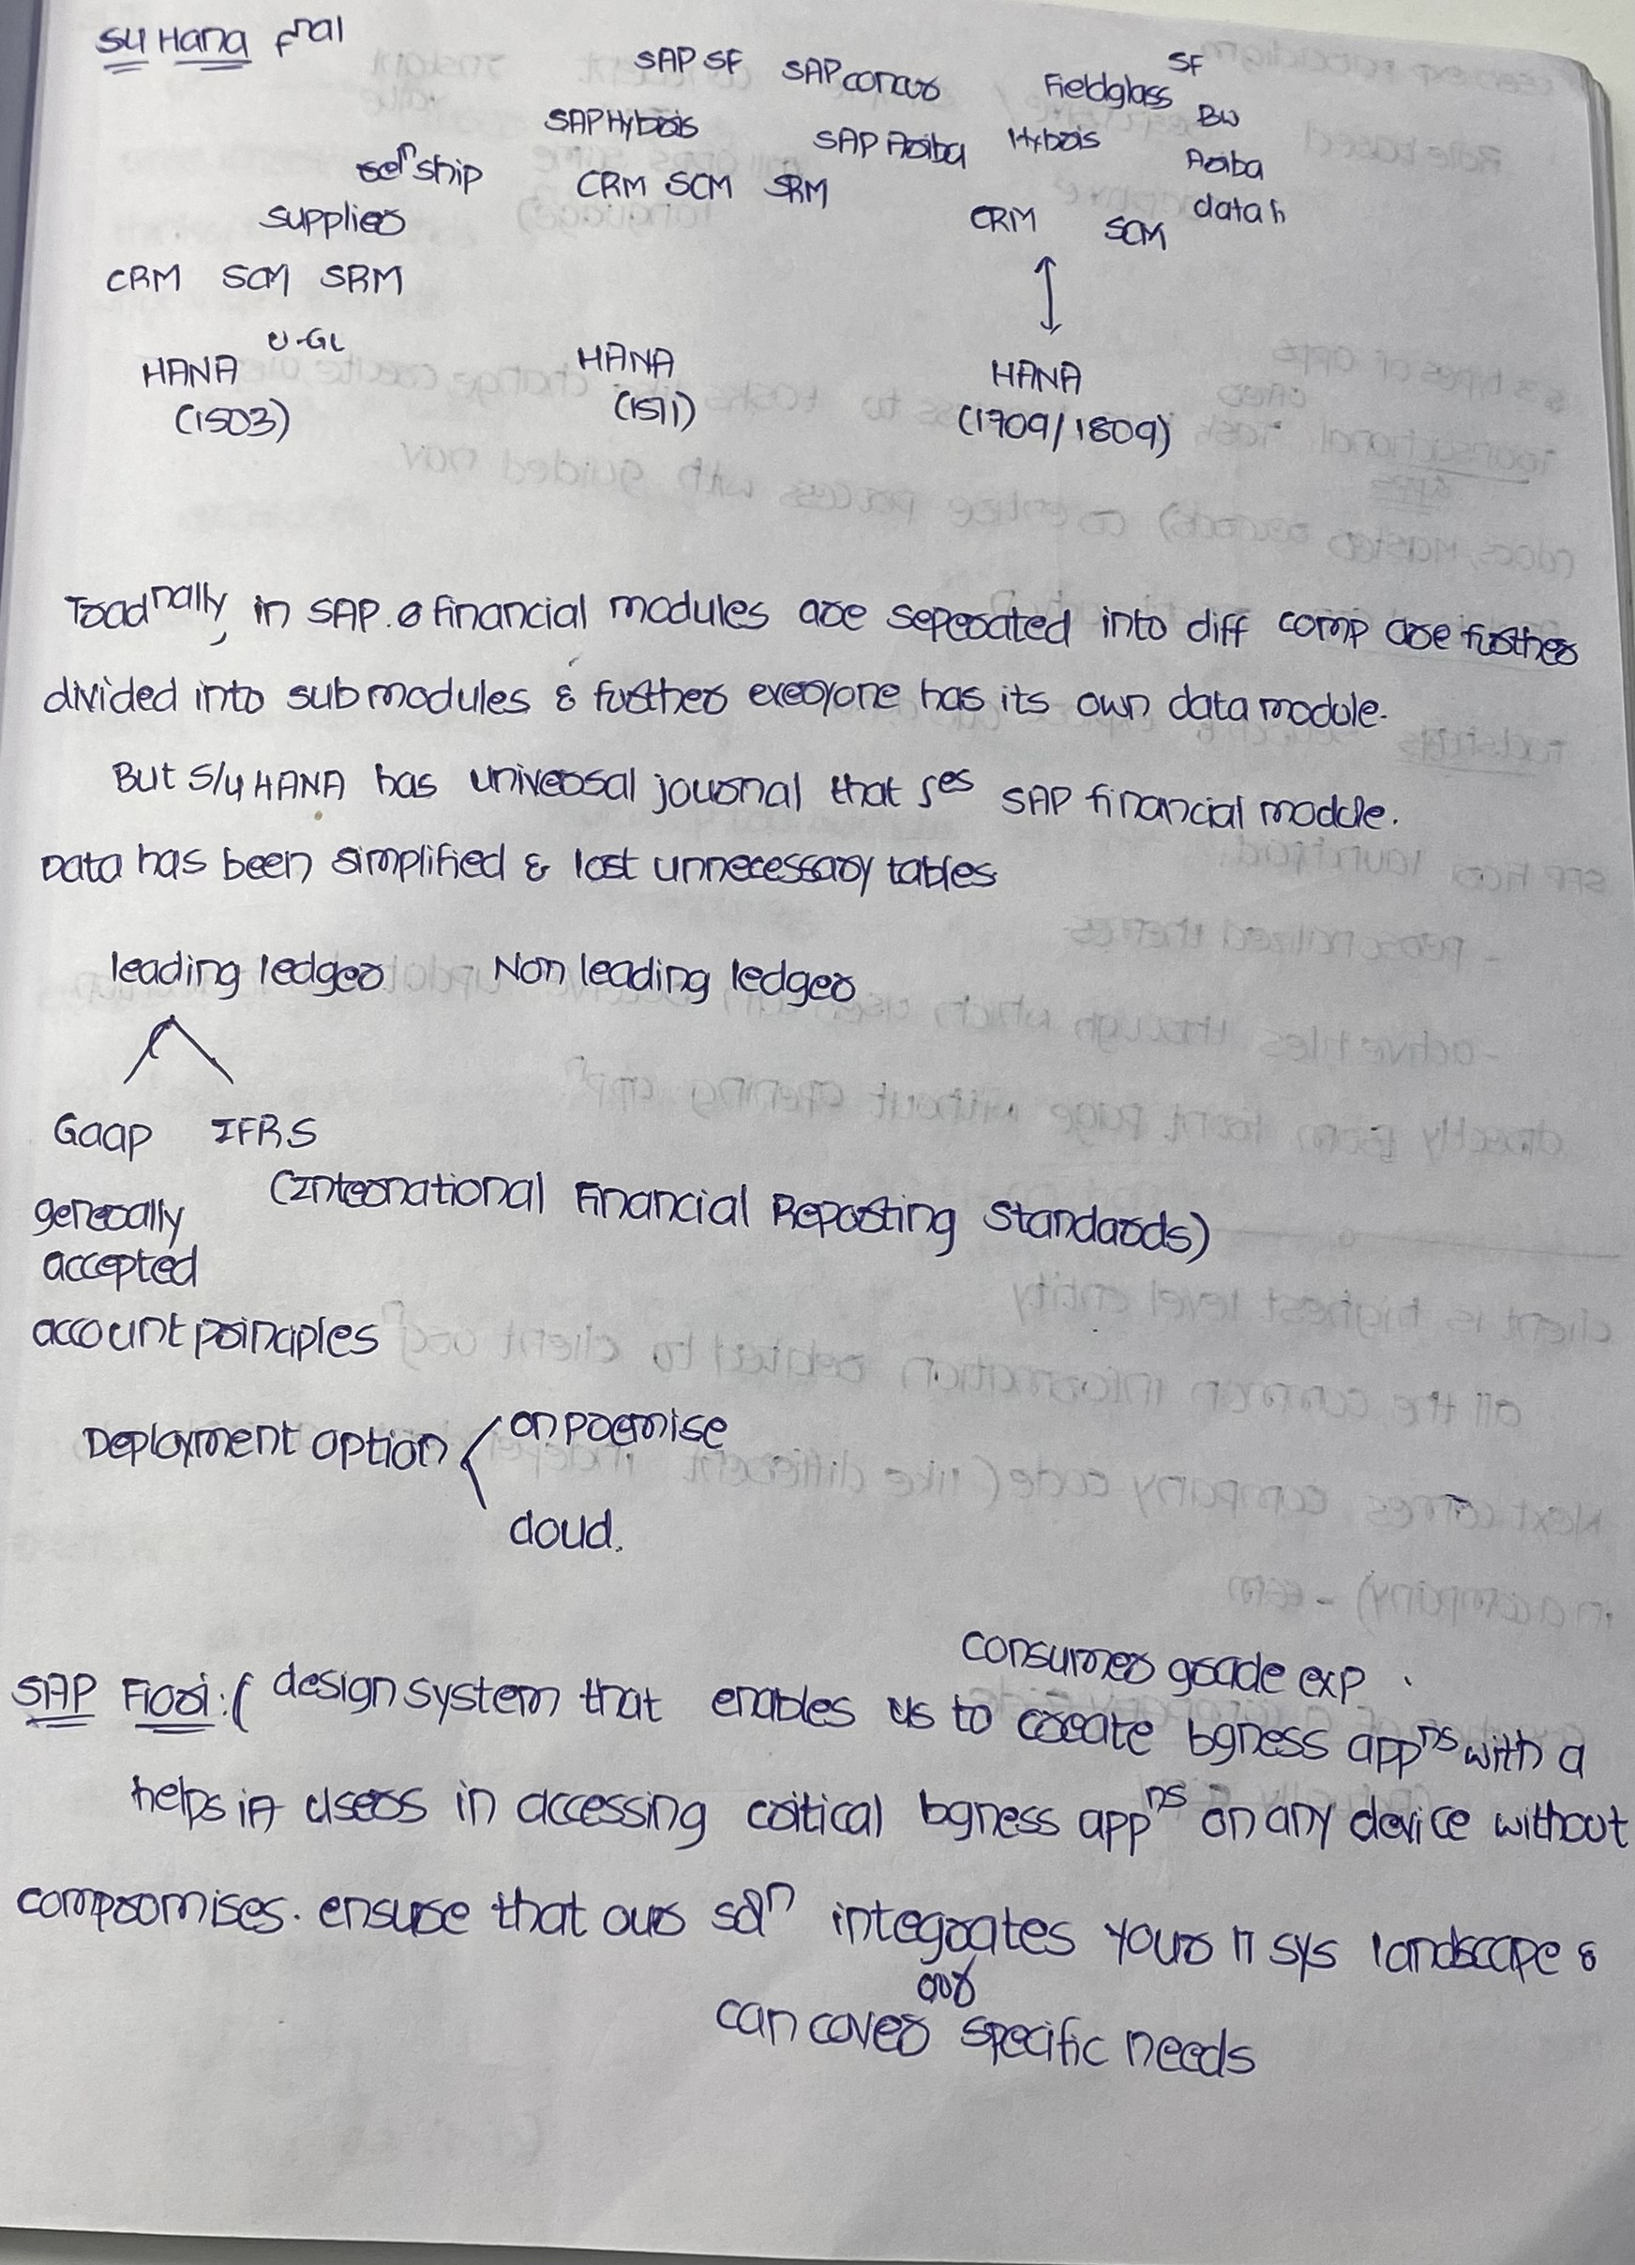
Learning 1 | My takeaways
Key learnings: I have learned introduction of sap HANA (High Performance Analytic Appliance) and overview of changes that are made from ecc to HANA.
Key Takeaways: SAP HANA offers in-memory computing, real-time analytics, and integration with AI and IoT technologies, significantly speeding up data processing and report generation. Overview of Changes: Recent updates include the introduction of SAP HANA Cloud’s Vector Engine, and improved data management and analytics capabilities.
Shell uses SAP HANA to enhance its Wells & Reservoir Facility Management (WRFM) system by integrating data from over 20 sources for real-time analytics and performance improvements.
[Add a graphic that provides evidence of what you learned]

Slide 5
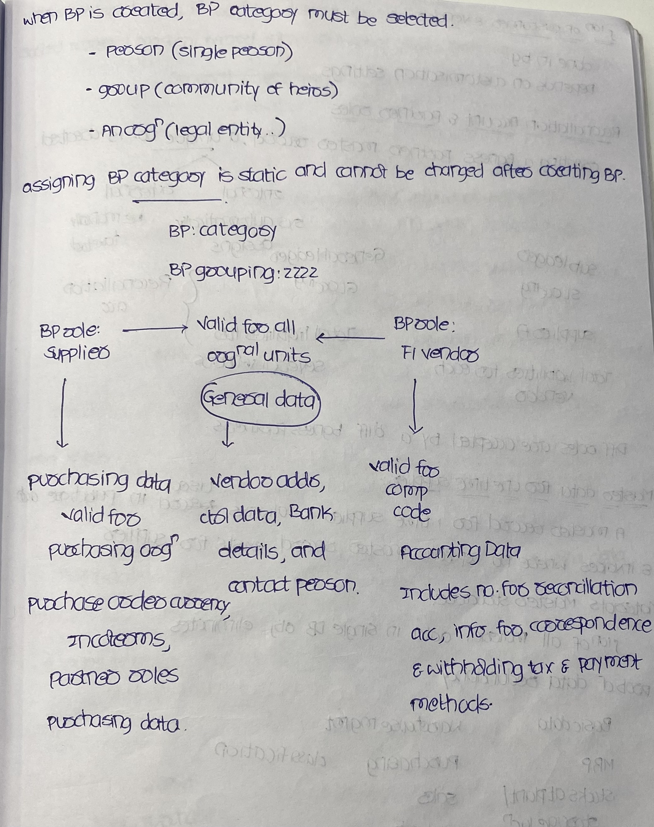
Learning 2 | My takeaways
Key Learnings: I have learned how to create business partner and how to assign roles to it and also learned about material master data and material valuation.
Key takeaways: Business Partner (Customer and Vendor) can be created using Transaction code BP. Roles can be assigned in it. Material master can be created using MM01 and changed using MM02 and displayed using MM03.
Shell uses business partner data to centrally manage customer and vendor information, and material master data to streamline procurement and inventory processes
[Add a graphic that provides evidence of what you learned]

Slide 6
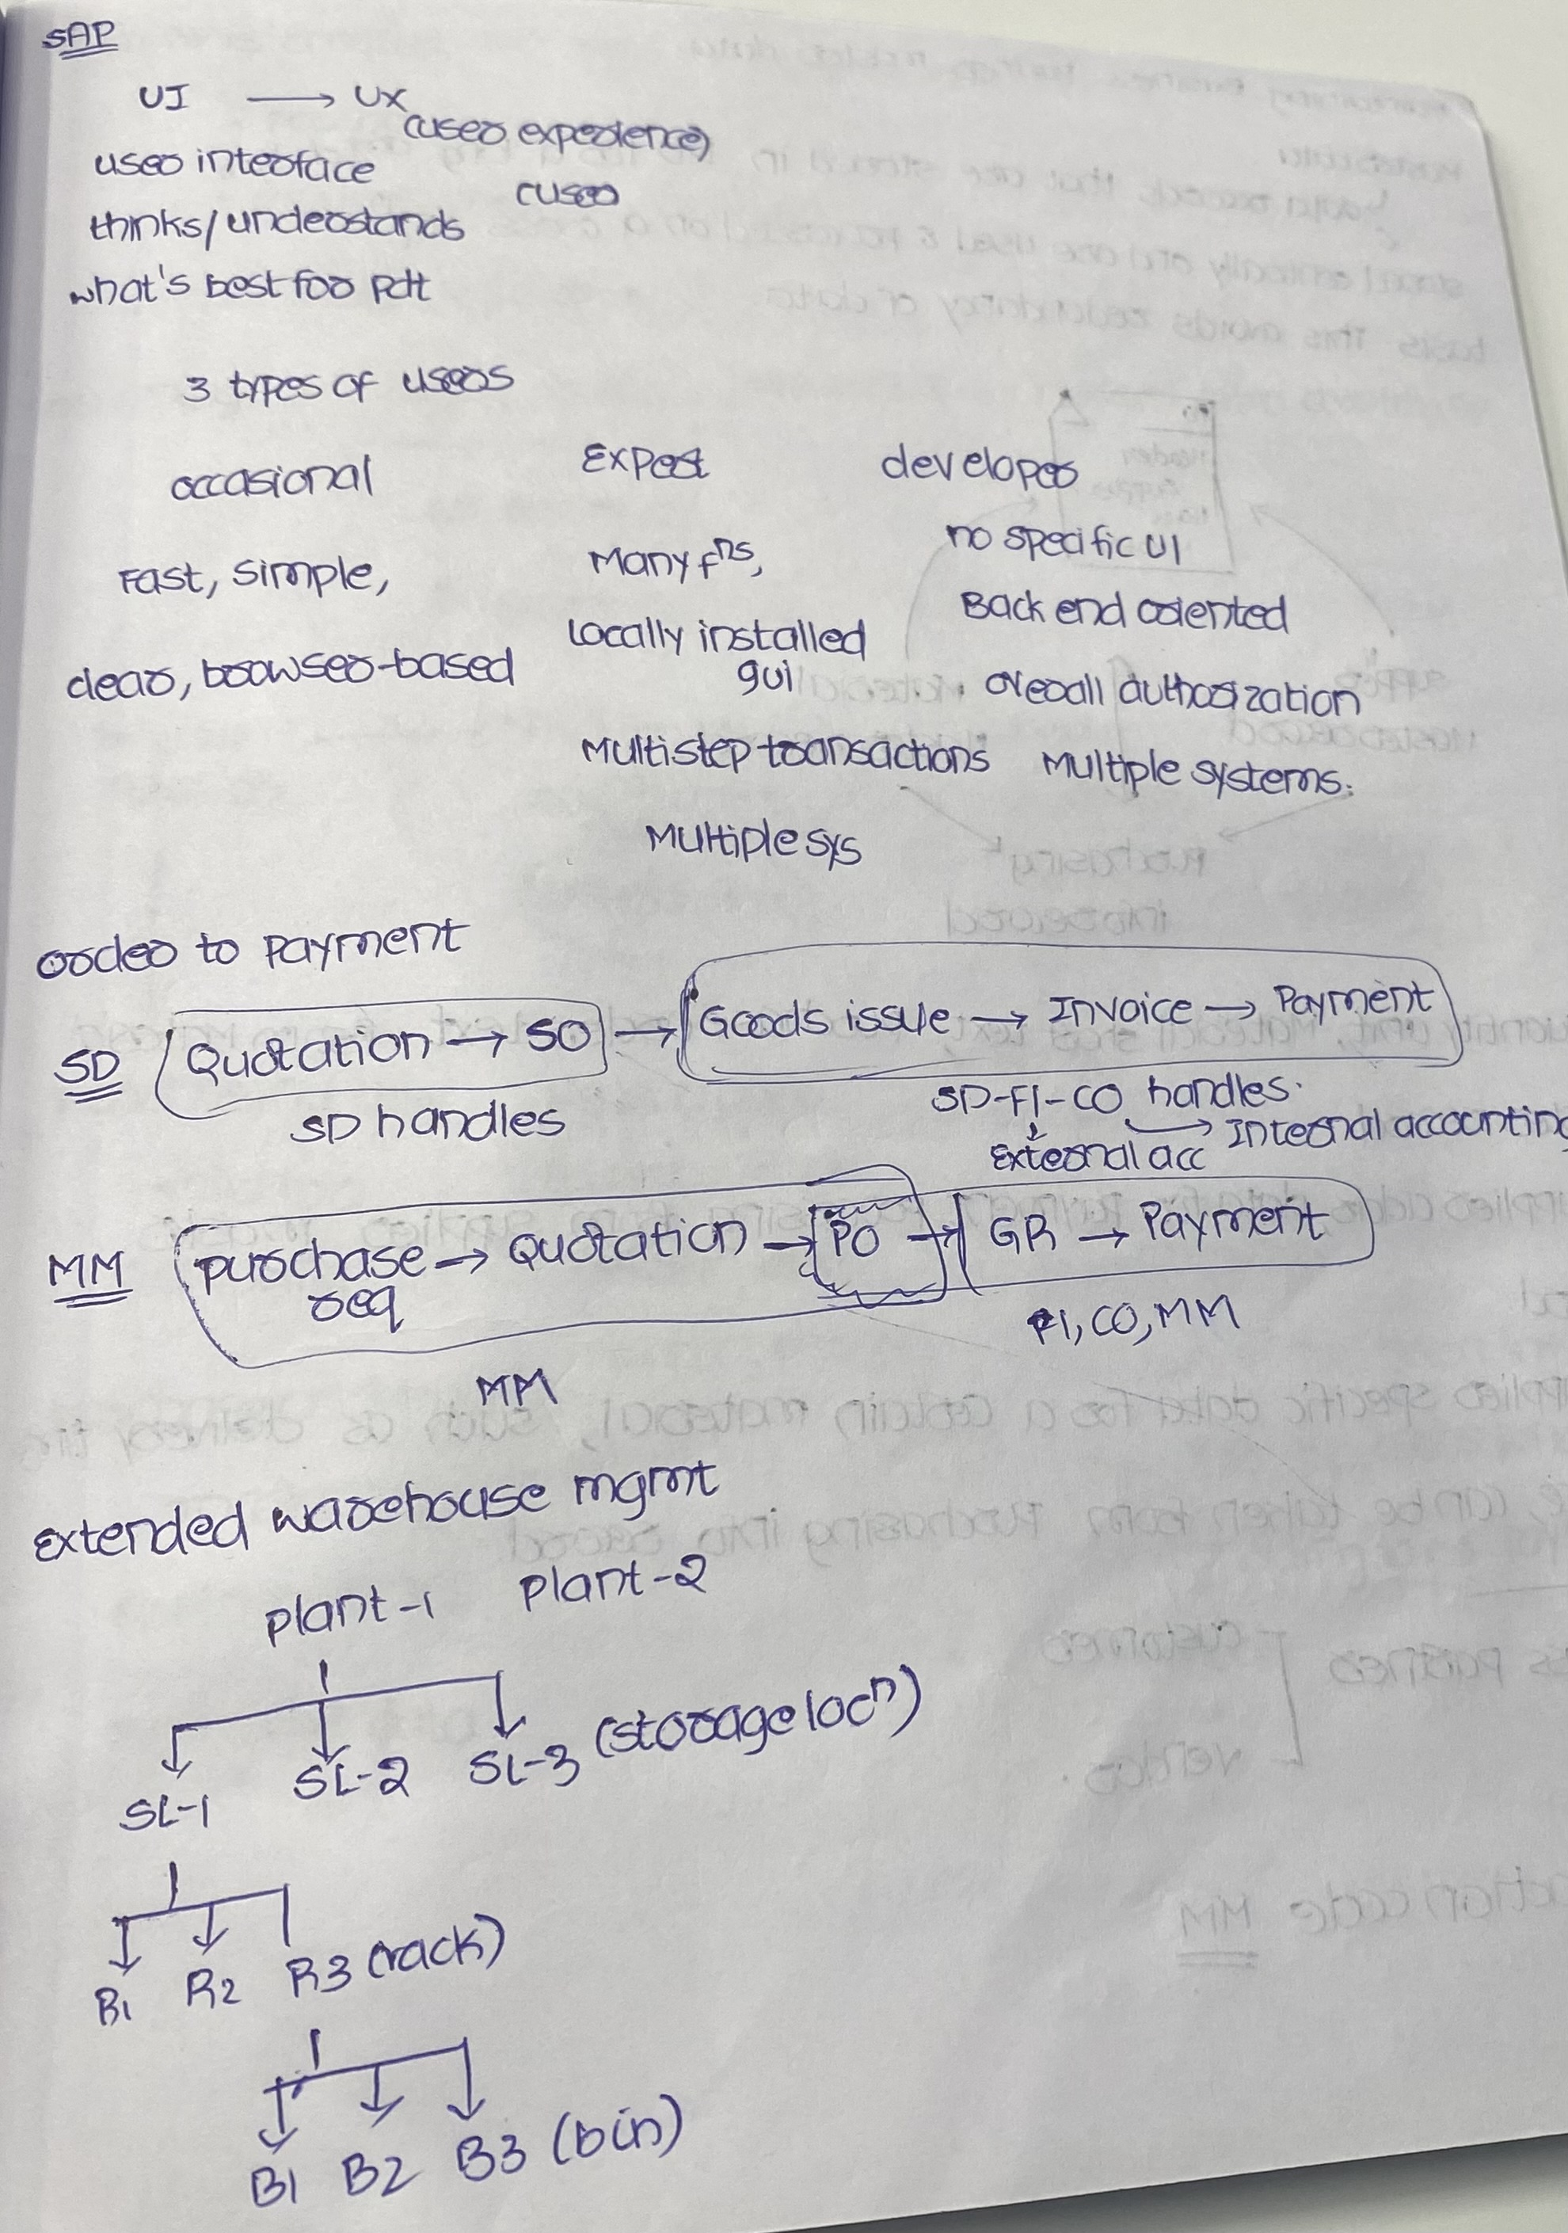
Learning 3 | My takeaways
Key learnings: I have learned Order to Cash flow that happens in Sales and Distribution module and also procure to pay flow that happens in Material Management module.
Key takeaways: Order to Cash flow: Quotation -> Sales Order -> Goods issue -> Invoice -> Payment. Procure to Pay flow: Purchase Requisition -> Request for Quotation -> Purchase order -> Goods Receive -> Payment.
Shell uses the Order-to-Cash (OTC) process to manage customer orders and cash inflows, while the Procure-to-Pay (P2P) process handles sourcing, purchasing, and payments for goods and services.
[Add a graphic that provides evidence of what you learned]

Slide 7

Relevance of learnings for my organization

Slide 8
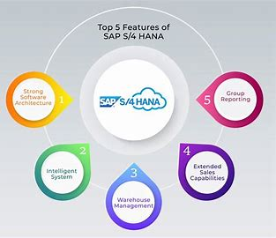
Learning 1 | Relevance for Shell
SAP S/4 HANA simplifies business processes by integrating various functions into a single, unified system. This reduces complexity and enhances operational efficiency, allowing Shell India to focus on core business activities.
The platform ensures that all departments and functions within Shell India are aligned. This alignment fosters better communication and collaboration across the enterprise, leading to more cohesive and strategic decision-making.
[Add a graphic that provides view of how Shell implements this learning]

Slide 9
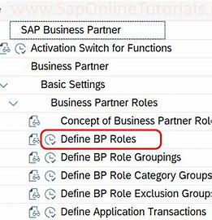
Learning 2 | Relevance for Shell
In SAP S/4HANA, Business Partner (BP) master data integrates customer and vendor data into a single entity, simplifying management and reducing redundancy1. This centralization ensures consistent and accurate data across various business functions, enhancing efficiency and decision-making2.
Material Master Data is crucial for managing product-related information, ensuring accurate inventory, procurement, and sales processes3. For a company like Shell, this integration supports streamlined operations, better data accuracy, and improved compliance.
[Add a graphic that provides view of how Shell implements this learning]

Slide 10
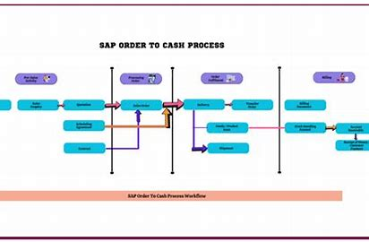
Learning 3 | Relevance for Shell
OTC is a critical process that involves managing customer orders and the cash inflow from those orders. For Shell, this process ensures that customer orders are efficiently processed, fulfilled, and payments are collected promptly.
P2P involves the entire procurement process from sourcing and purchasing to payment for goods and services. For Shell, this process is crucial for managing supplier relationships and ensuring timely procurement of necessary resources.
[Add a graphic that provides view of how Shell implements this learning]

Slide 11

Challenges in implementing learning

Slide 12
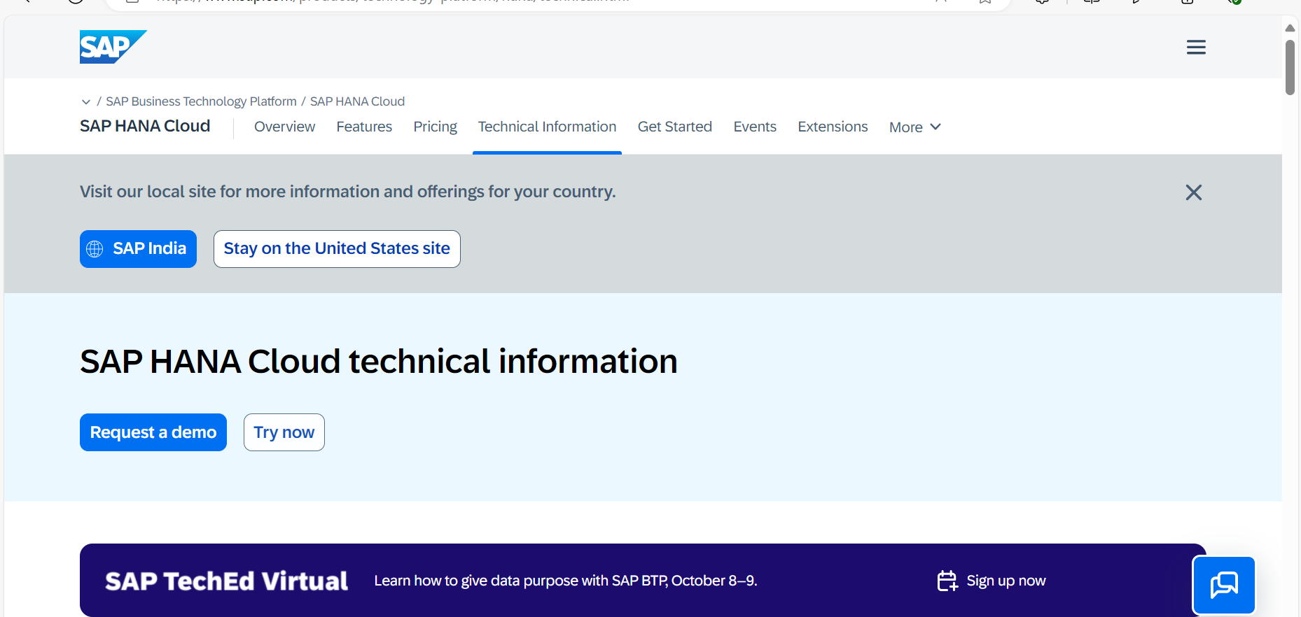
Challenge faced while implementing Learning 1
Challenge: SAP HANA involves a lot of technical jargon and concepts that can be overwhelming at first.
Plan: I started reading documentation of SAP HANA to be more familiar and clear with the concepts.
[Add a graphic that provides evidence of what you did to overcome this challenge]

Slide 13
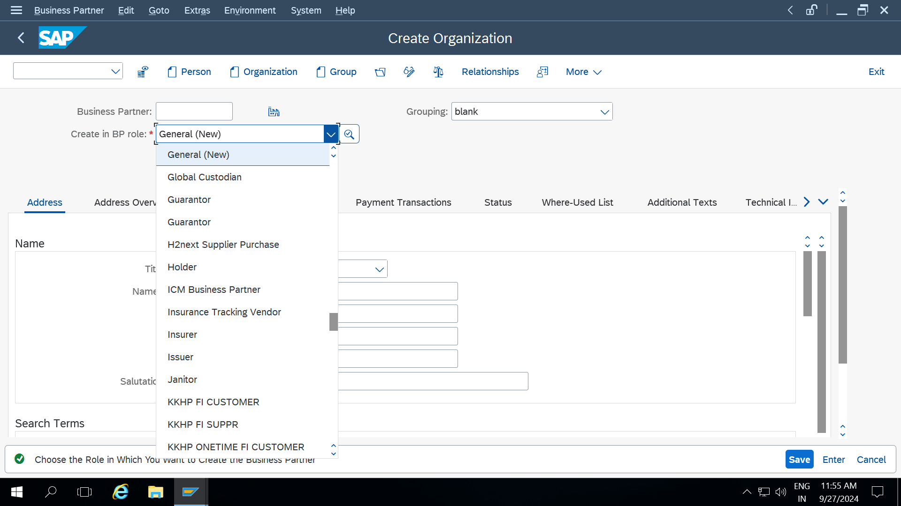
Challenge faced while implementing Learning 2
Challenge: Assigning roles to business partner has been bit confusing because there are many roles that can be assigned to it like accounting , FI and so..on
Plan: Created few business partner master data to be more familiar and be clear with assigning the role.

Slide 14
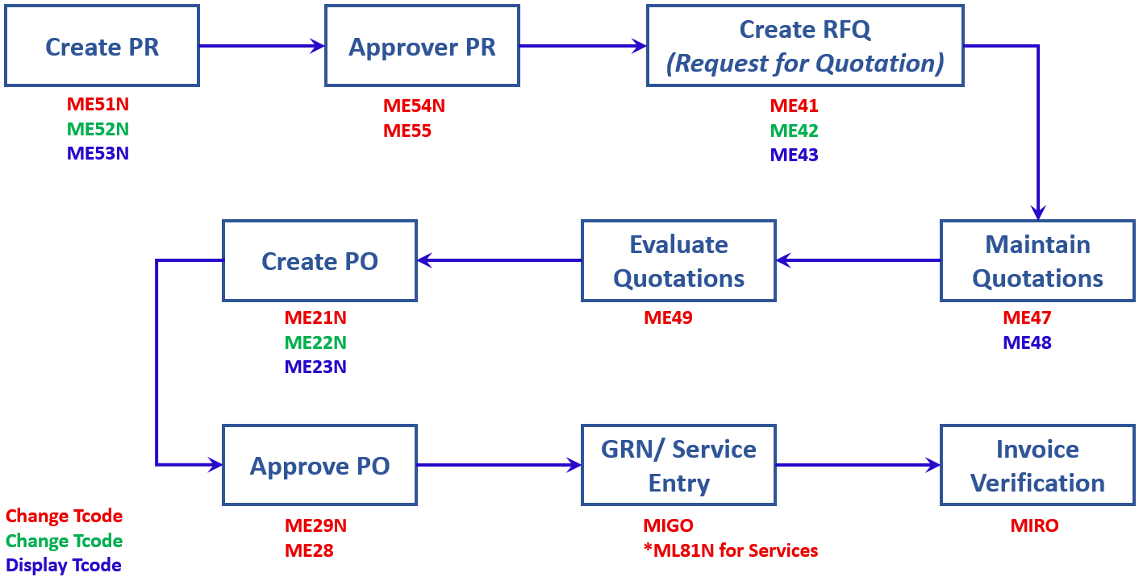
Challenge faced while implementing Learning 3
Challenge: OTC and P2P involved lot of T-codes which was bit difficult to remember.
Plan: Read T-codes more frequently.
[Add a graphic that provides evidence of what you did to overcome this challenge]

Slide 15

Action Plan

Slide 16
My Action Plan for this Week
Actions
Timeline
Status
Master the concepts of SAP and S4 HANA and BTP and functional modules of SAP
Be familiar with the roles in Business partner
Be thorough with the T-codes
By end of the week
Completed

Slide 17

Learning is also Fun!

Slide 18

Learning is also Fun!
My facilitator for ERP Function Mr Vignesh has been very great teacher and made sessions very interactive and fun. He made all the sessions hands on.
So it has been very easy to understand since everything was practical.
[Add a graphic or a picture of how you/your team enjoyed the new learning]

Slide 19

Summary
Quick Summary:
SAP HANA is a combination of HANA database and data modelling and HANA administration and data provisioning in a single use.
Order-to-Cash (OTC) focuses on managing customer orders and cash inflow, while Procure-to-Pay (P2P) deals with sourcing, purchasing, and payment for goods and services.
In SAP, Business Partner master data includes information about entities like customers, vendors, or employees, while Material master data contains details about products or services used in various business processes12.

Slide 20
Thank You

